Slide 1

Introduction to Project Management
What have been the big technological developments, the big leaps forward in IT?
ECU Copyright 2015 – CSG2344 School of Computer and Security Science

Slide 2
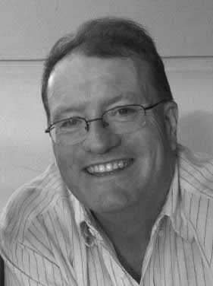
Lecturer details
David Cook
Office: ML 13.238
Tel: 6304 5104
Email: d.cook@ecu.edu.au
ECU Copyright 2015 – CSG2344 School of Computer and Security Science

Slide 3
Module Objectives
Locate and understand unit materials
Define “project” and “project management”
Understand factors that contribute to IT project success
Consider traits of effective project managers
ECU Copyright 2015 – CSG2344 School of Computer and Security Science

Slide 4
Teaching format and resources
Lecture 2 hours, workshops / tutorials 1 hour
Textbook : Author - Schwalbe, K. (2015)
Information Technology Project Management.
(7th Edition)
PMBOK ( Project Management Body of Knowledge 5th Ed)
unit materials available on Blackboard
Additional readings available on blackboard.
ECU Copyright 2015 – CSG2344 School of Computer and Security Science

Slide 5
Assessment
- Assignment 1: 20%
Individual
10 online multi-choice tests
- Assignment 2: 40%
group project
May have online student(s) in team
Involves anonymous peer assessment
- Examination 40%
ECU Copyright 2015 – CSG2344 School of Computer and Security Science

Slide 6

ECU Policy on Academic Misconduct
- Severe penalties for
Cheating
Plagiarism
Collusion
- Read the Uni rules at:
http://www.ecu.edu.au/GPPS/governance_services/resources_file/admission_enrolment_and_academic_progress_rules_(090827).pdf
ECU Copyright 2015 – CSG2344 School of Computer and Security Science

Slide 7
Problems / Challenges
Please discuss them with the tutor in the first instance
If you are not satisfied then you can discuss them with the
1. Unit Co-ordinator
2. Course Co-ordinator
3. Student Counsellor
Don’t wait until the day something is due before alerting your lecturer to a problem
ECU Copyright 2015 – CSG2344 School of Computer and Security Science

Slide 8
Extensions
Extensions will only be given where documented evidence is available
Medical Certificate, Counselor’s stipulation
Work and Travel are not grounds for extensions
Rules for extensions can be found at; http://www.ecu.edu.au/student/assignment/index.php
ECU Copyright 2015 – CSG2344 School of Computer and Security Science

Slide 9
Occupational Safety and Health
Alarms
Warning
Evacuation
Assembly points
Please read details on the above points at: http://intranet.ecu.edu.au/__data/assets/pdf_file/0004/624604/ECU-Mt-Lawley-Emergency-Manuals-Sep-2014-Issue-1.pdf
Lab safety
Enclosed footwear only
ECU Copyright 2015 – CSG2344 School of Computer and Security Science

Slide 10
The Need for Project Management
- Computing is still a young field
- Very early computer programs were
aimed at efficiency of a known algorithm
written maintained and used by an individual
no systematic methods - more art form than science
Today’s applications are
found in every sphere of our lives
often large, complex
developed by teams
- What have been the big steps forward in computing since the early days?
ECU Copyright 2015 – CSG2344 School of Computer and Security Science

Slide 11
The emerging reliance on Software
growing gap between demand and supply
expectation for software delivery to be
on time,
on budget
meeting requirements
maintenance problem
base of existing software needs fixing/changing
What is the proportion of new to existing software?
society increasingly dependent on reliable high quality software
ECU Copyright 2015 – CSG2344 School of Computer and Security Science

Slide 12
The Track Record
What is the state of the software industry today?
Is there demand for software?
If so what types?
Do we develop applications well?
How do we know how well we do?
Are there areas for improvement?
ECU Copyright 2015 – CSG2344 School of Computer and Security Science

Slide 13
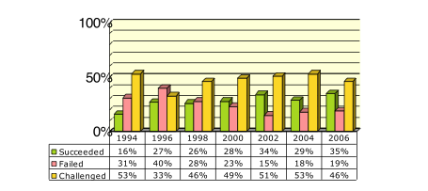

IT Project Success
“More IT Projects are succeeding”
ECU Copyright 2015 – CSG2344 School of Computer and Security Science

Slide 14
Why has the state of play improved?
“The reasons for the increase in successful projects vary.
- better tools have been created to monitor and control progress and
- better skilled project managers with
- better management processes are being used.
The fact that there are processes is significant in itself.”
ECU Copyright 2015 – CSG2344 School of Computer and Security Science

Slide 15
Why do projects fail?
The user did not know what he wanted
The user changed his mind
The programmers missed deadlines
The programmers were called to other projects
The software support changed halfway
The user changed his mind again
The due dates were impossible anyway
The user left the job
ECU Copyright 2015 – CSG2344 School of Computer and Security Science

Slide 16
Why do projects fail?
The user did not know what he wanted
The user changed his mind
The programmers missed deadlines
The programmers were called to other projects
The software support changed halfway
The user changed his mind again
The due dates were impossible anyway
The user left the job REALLY ???

Slide 17
Why projects fail … the Truth
- Poor project management
- Lack of a systematic process
- Larger projects have the lowest success rate/are more risky than medium and smaller projects
- Technology, business models and markets change so rapidly that a project that takes more than a year can be obsolete before they are completed
- Inadequate support from top management
- Poor communication with client
- Neglecting the Human Factor
- Untested technology
ECU Copyright 2015 – CSG2344 School of Computer and Security Science

Slide 18
Why projects fail … the Truth
- Poor project management
- Lack of a systematic process
- Larger projects have the lowest success rate/are more risky than medium and smaller projects
- Technology, business models and markets change so rapidly that a project that takes more than a year can be obsolete before they are completed
- Inadequate support from top management
- Poor communication with client
- Neglecting the Human Factor
- Untested technology
Therefore… POOR PROJECT MANAGEMENT

Slide 19
Top 10 Factors for IT Success
Rank | Success Factors
1 | Executive Support
2 | User Involvement
3 | Experienced Project Manager
4 | Clear Business Objectives
5 | Minimized Scope
6 | Standard Software Infrastructure
7 | Firm Basic Requirements
8 | Formal Methodology
9 | Reliable Estimates
10 | Other
ECU Copyright 2015 – CSG2344 School of Computer and Security Science

Slide 20
Job Descriptions
A statistician is someone who is good with numbers but lacks the personality to be an accountant.
A lawyer is a person who writes a 10,000-word document and calls it a “brief”.
A professor is one who talks in someone else's sleep...!!
A Project Manager is ????
ECU Copyright 2015 – CSG2344 School of Computer and Security Science

Slide 21
Activity
Form groups of people and discuss the following questions:
What is a project? Give examples.
What is a project manager?
What makes a project manager successful?
Have one person in your group share your collected thoughts with the rest of the class
ECU Copyright 2015 – CSG2344 School of Computer and Security Science

Slide 22
What is a Project?
A project is a temporary endeavor undertaken to accomplish a unique purpose.
It has an end date.
Project management is the application of knowledge, skills, tools, and techniques to project activities in order to
meet project requirements (scope)
on time (time)
on budget (cost)
at appropriate quality (quality)
ECU Copyright 2015 – CSG2344 School of Computer and Security Science

Slide 23
PMBOK
Project Integration Management
Scope
Time
Cost
Quality
Human Resource
Communications
Risk
Procurement
Stakeholder

Slide 24
Project Integration Management
This is the coordination of all areas and so is actually made up of a plan for each of the 9 other knowledge or functional areas
It involves ensuring that all other 9 areas are being managed properly.
Note that as of 2014 we cite the 10 knowledge management areas ( previous versions of PMBOK and Schwalbe do not include Stakeholder Management).
ECU Copyright 2015 – CSG2344 School of Computer and Security Science

Slide 25
Knowledge Areas within Project Management
Four core knowledge areas lead to specific project objectives
Project scope management
involves defining and managing all the tasks required to complete the project successfully.
Project time management
includes estimating how long it will take to complete the work, developing an acceptable project schedule, and ensuring timely completion of the project.
Project cost management
consists of preparing and managing the budget for the project.
Project quality management
ensures that the project will satisfy the stated or implied needs for which it was undertaken.
ECU Copyright 2015 – CSG2344 School of Computer and Security Science

Slide 26
Knowledge Areas (continued...)
project objectives achievement areas:
Project human resource management
concerned with making effective use of the people involved with the project.
Project communications management
involves generating, collecting, disseminating, and storing project information.
Project risk management
includes identifying, analyzing, and responding to risks related to the project.
Project procurement management
involves acquiring or procuring goods and services for a project from outside the performing organization.
Project Stakeholder management
Request, Reject, support, approve, and oppose projects from stakeholder perspective.
ECU Copyright 2015 – CSG2344 School of Computer and Security Science

Slide 27
The Triple Constraint
Every project is constrained in different ways:
Scope: What tasks will be done as part of the project? What unique product, service, or result does the customer or sponsor expect from the project?
Time: How long should it take to complete the project? What is the project’s schedule?
Cost: What should it cost to complete the project? What is the project’s budget?
ECU Copyright 2015 – CSG2344 School of Computer and Security Science

Slide 28
The Fourth Constraint
The quadruple constraint now includes Quality
It is the project manager’s duty to balance these often competing goals.
What is the issue with “Quality”
ECU Copyright 2015 – CSG2344 School of Computer and Security Science

Slide 29
What should a Project Manager be competent in?
Create a list of ten areas a project manager should be skilled in
Take a few minutes to make a list.
ECU Copyright 2015 – CSG2344 School of Computer and Security Science

Slide 30
Characteristics of Project Managers
Effective Project Managers | Ineffective Project Managers
Lead by example | Set bad examples
Are visionaries | Are not self-assured
Are technically competent | Lack technical expertise
Are decisive | Avoid or delay making decisions
Are good communicators | Are poor communicators
Are good motivators | Are poor motivators
ECU Copyright 2015 – CSG2344 School of Computer and Security Science

Slide 31
The need for Leadership
Effective project managers provide leadership by example.
- A leader focuses on long-term goals and big-picture objectives while inspiring people to reach those goals.
- A manager deals with the day-to-day details of meeting specific goals.
- Project managers often take on the role of both leader and manager.
ECU Copyright 2015 – CSG2344 School of Computer and Security Science

Slide 32
PM Certification
The Project Management Institute provides certification as a Project Management Professional (PMP).
A PMP has documented sufficient project experience, agreed to follow a code of ethics, and passed the PMP exam.
The number of people earning PMP certification is increasing quickly.
(5000 – 10000 new people per month)
ECU Copyright 2015 – CSG2344 School of Computer and Security Science

Slide 33
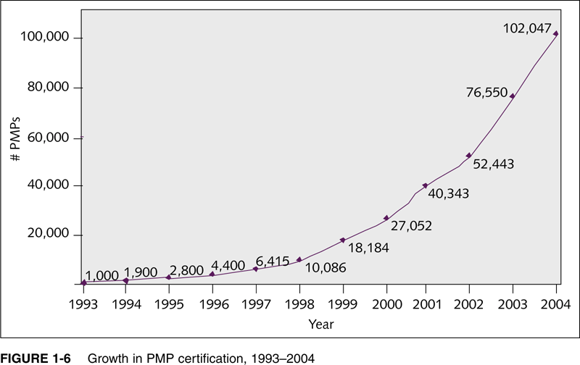
Growth in Certification
ECU Copyright 2015 – CSG2344 School of Computer and Security Science

Slide 34
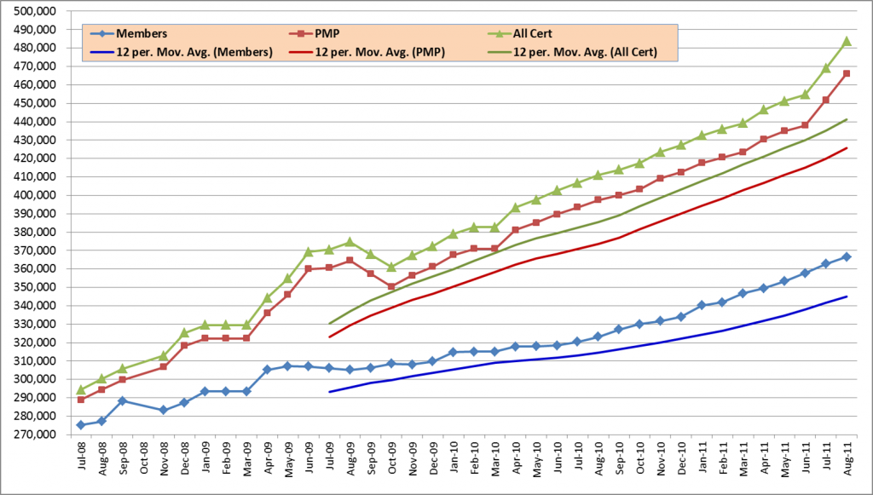
Growth in Certification
ECU Copyright 2015 – CSG2344 School of Computer and Security Science

Slide 35
Ethics in Project Management
Ethics is an important part of all professions.
Project managers often face ethical dilemmas.
In order to earn PMP certification, applicants must agree to the PMP code of professional conduct.
ECU Copyright 2015 – CSG2344 School of Computer and Security Science

Slide 36
Tools, Programs, Apps
There are 1000s of different products available today.
- Three main categories of tools are the following:
Low-end tools: Allow for small projects – the best examples are apps such as Trello, Podio, Basecamp
Midrange tools: Handle multiple projects and users; cost $200-500 per user; MS Project 2010 is the most popular
High-end tools: Also called enterprise project management software; often licensed on a per-user basis; example is VPMi Enterprise Online (www.vcsonline.com)
ECU Copyright 2015 – CSG2344 School of Computer and Security Science

Slide 37
MS Project
Since MS Project is the most widely-used tool for Project Management – this unit allows you to download a free Full Version of MS Project from the School Website.
It is a useful skill ( and helpful for your CV) to be able to state a proficiency in using MS Project.
Please download it to a machine (either your own laptop or desk-top machine)
There are several youtube clips that explain how to get started on MS Project.
Those with Apple products contact d.cook@ecu.edu.au for work-arounds.
ECU Copyright 2015 – CSG2344 School of Computer and Security Science

Slide 38
Summary
Unit materials
“project” and “project management” defined
PMBOK
Factors that contribute to IT project success
Traits of effective project managers
MS Project – getting started.
ECU Copyright 2015 – CSG2344 School of Computer and Security Science

